Slide 1

More about Loop Optimization
Cong (Callie) Hao
callie.hao@ece.gatech.edu
Assistant Professor
ECE, Georgia Institute of Technology
Sharc-lab @ Georgia Tech https://sharclab.ece.gatech.edu/

Slide 2

Hardware Design with HLS
Where does performance gain come from?
Specialization
Parallelization
Data-type
Arbitrary fixed-point precision, customized floating-point precision
Memory and data movement
Customized data storage in banks
Customized data loading and feeding
Computation
How do you schedule the computations?
Order, granularity, etc.
Operation level parallelism
Multiple operations or instructions executed simultaneously
Mostly about loop manipulation and data partitioning
Task level parallelism (TLP)
Dataflow and streaming
Overlapped compute and data movement

Slide 3
Put-together: Pipeline + Unroll +Partition
The three techniques are frequently used together to boost computation efficiency
#pragma HLS array_partition variable=A dim=2 complete
#pragma HLS array_partition variable=B dim=2 complete
#pragma HLS array_partition variable=C dim=2 complete
for (int i = 0; i < N; i++) {
#pragma HLS pipeline II=1
for (int j = 0; j < M; j++) {
#pragma HLS unroll
A[i][j] = B[i][j] * C[i][j];
}
}
i=0
i=2
i=1
Outer loop pipelining will enforce all inner loops fully unrolled. Why?
i=0
i=1
i=2

Slide 4
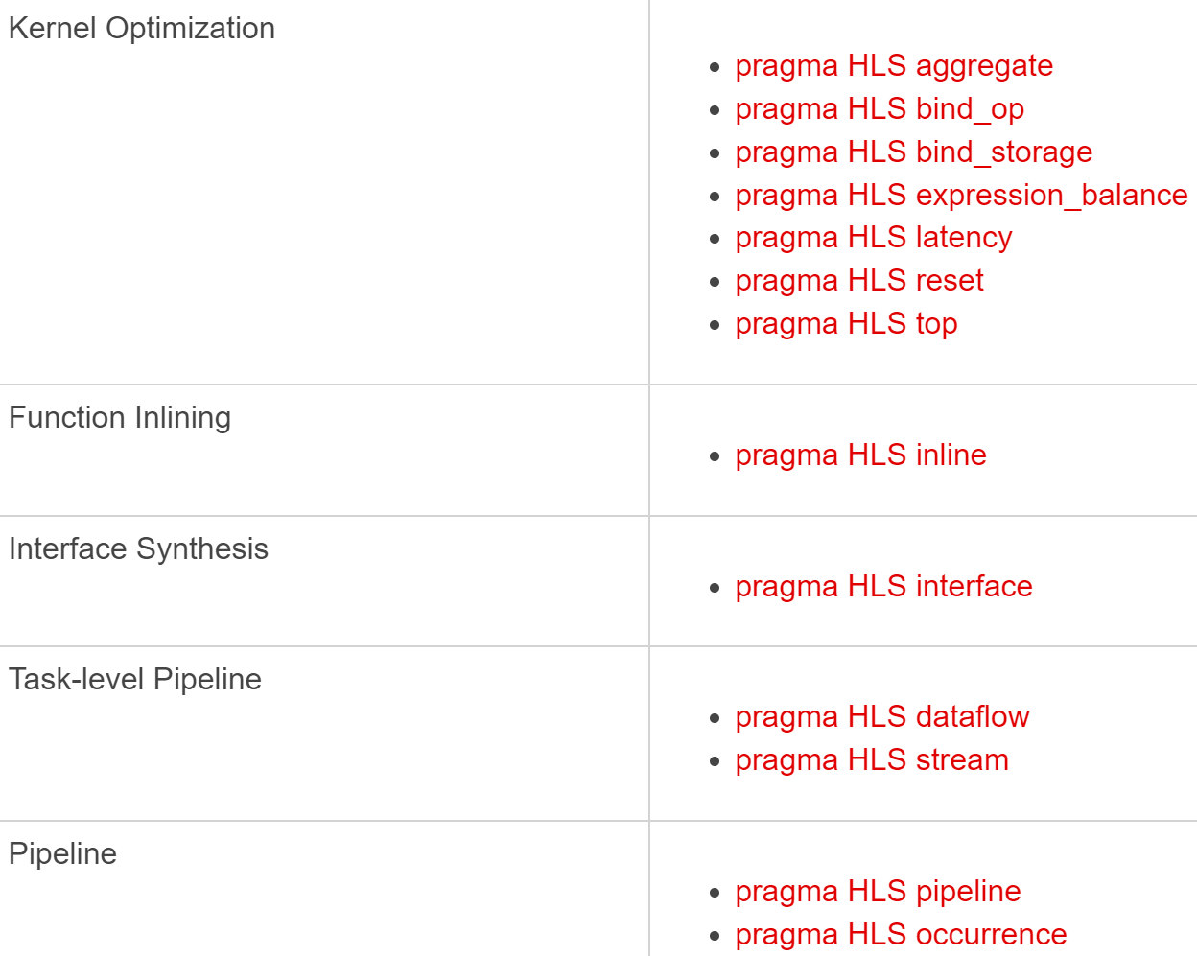
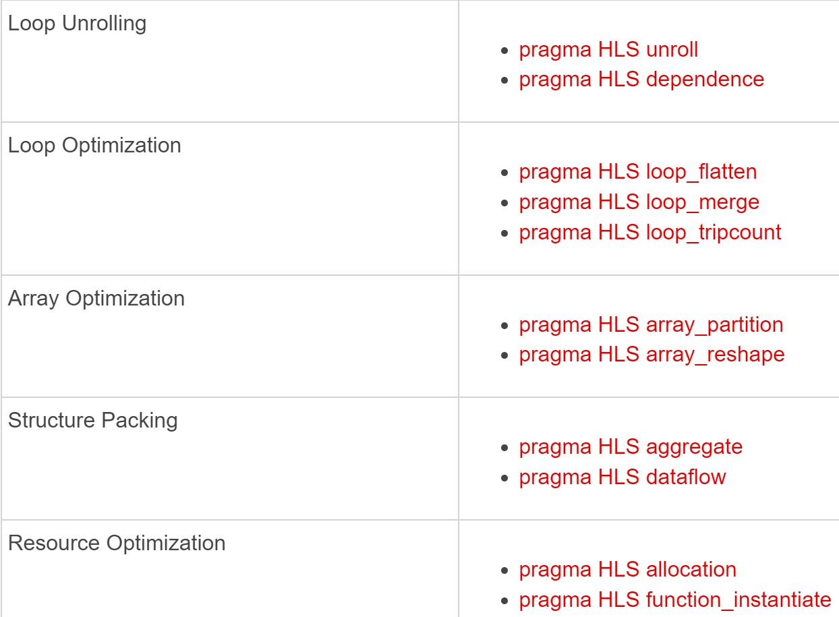
HLS Pragmas
A lot of useful “pragma”s: tell your compiler how to build the hardware
This link has all the pragmas you need:
https://docs.xilinx.com/r/en-US/ug1399-vitis-hls/HLS-Pragmas

Slide 5


More HLS Resources
This link has everything you need to know about HLS…
https://docs.xilinx.com/r/en-US/ug1399-vitis-hls/Getting-Started-with-Vitis-HLS
I can be 100% substituted by this link ☹
… or can I ???
Remember: using HLS for FPGA design is NOT all about playing with pragmas
It’s you designing an architecture, using HLS to achieve your goal
I want to optimize my design in such a way… (e.g., hey, these operations can be parallelized!)
Let me see what are those pragmas?
Try to use them to optimize my design
Let me check if there’s a pragma (with code rewrite) that can achieve my goal

Slide 6
Put-together: Pipeline + Unroll +Partition
The three techniques are frequently used together to boost computation efficiency
#pragma HLS array_partition variable=A dim=2 complete
#pragma HLS array_partition variable=B dim=2 complete
#pragma HLS array_partition variable=C dim=2 complete
for (int i = 0; i < N; i++) {
#pragma HLS pipeline II=1
for (int j = 0; j < M; j++) {
#pragma HLS unroll
A[i][j] = B[i][j] * C[i][j];
}
}
i=0
i=2
i=1
i=0
i=1
i=2

Slide 7
Effective Region of Unroll and Pipeline
Both Pipeline and Unroll must act on a loop, i.e., within a loop region
void top( ports ) {
for(int i = 0; i < 512; i++) {
for(int j = 0; j < 1024; j++) {
#pragma HLS pipeline
sum[i] += A[i][j] * B[i][j];
}
}
}
j
i=0
j
i=1

Slide 8
Effective Region of Unroll and Pipeline
Both Pipeline and Unroll must act on a loop, i.e., within a loop region
void top( ports ) {
for(int i = 0; i < 512; i++) {
for(int j = 0; j < 1024; j++) {
#pragma HLS unroll
sum[i] += A[i][j] * B[i][j];
}
}
}
j
i=0
j
i=1

Slide 9
Effective Region of Unroll and Pipeline
Both Pipeline and Unroll must act on a loop, i.e., within a loop region
void top( ports ) {
for(int i = 0; i < 512; i++) {
#pragma HLS pipeline
for(int j = 0; j < 1024; j++) {
#pragma HLS unroll
sum[i] += A[i][j] * B[i][j];
}
}
}
j
i=0
j
i=1
Note: the pipeline will enforce the inner loop being completely unrolled!
Could cause great scalability issue – discuss later
j
i=2

Slide 10
Effective Region of Unroll and Pipeline
Putting both pipeline and unroll together? WRONG! Pick only one!
The inner loops (j) are all unrolled
And the unrolled statements will be pipelined
void top( ports ) {
for(int i = 0; i < 512; i++) {
#pragma HLS pipeline
#pragma HLS unroll
for(int j = 0; j < 1024; j++) {
sum[i] += A[i][j] * B[i][j];
}
}
}
The inner loops are untouched
Outer loop is unrolled: generate 512 copies of i loop body

Slide 11
Unroll v.s. Pipeline
When to use which?
 | Pipeline | Unroll
Impact on inner loops | Enforce to be unrolled | No
Impact on inner functions | Enforce to be inlined | No
Loop-carried dependency | Handles dependency by staging | Cannot parallelize if there’s dependency
Resource usage | Reuse resource across iterations | Replicates resources for each unrolled copy
Nested loops | Used in outer loops | Used in inner loops

Slide 12
More Loop Optimizations
Initial Interval (II) Violation
Loop-carried Dependency
Loop reorder
Remove false dependency
Pipeline and Unroll over Functions
Loop Tiling and Partial Unroll
Loop Fusion
Parallel loops fused into single loop
Wrap loops into functions

Slide 13
A very Common Error: II Violation
What does II > 1 mean?
Pipeline is ready, but something blocks it from starting every cycle
Two Root Causes (99% of cases)
1️⃣ Resource Limitation: hardware cannot support one iteration per cycle
Common symptoms: Memory port limitation, Array not partitioned, Too many operations scheduled in one cycle, DRAM (m_axi) accessed inside a pipeline
Typical fixes: Partition on-chip arrays (array_partition), Copy data from DRAM to local buffers (BRAM / registers), Reduce unroll factor, Use loop tiling to control parallelism
2️⃣ Loop-Carried Dependency: An iteration depends on results from previous iterations.
Common symptoms: Accumulation (sum += ...), Read-after-write on the same variable, Conservative dependency assumed by HLS
Typical fixes: Reorder loops, Use local buffers or shift registers, Build an adder tree (avoid in-loop accumulation), Remove false dependency only if proven safe, (#pragma HLS dependence inter false)

Slide 14
The most important factor about pipelining
Initial Interval (II) – II violation
i=0
i=0
i=1
i=1
i=2
i=2
II = 1
II = 2

Slide 15
Causes to II violation
Not enough resource (e.g., memory not partitioned)
void test(int sum[10], int A[10][100], int B[10][100])
{
for(int i = 0; i < 10; i++) {
#pragma HLS pipeline
for(int j = 0; j < 100; j++) {
sum[i] += A[i][j] * B[i][j];
}
}
}

Slide 16
Causes to II violation
Not enough resource (e.g., memory not partitioned)
void test(int sum[10], int A[10][100], int B[10][100])
{
for(int i = 0; i < 10; i++) {
#pragma HLS pipeline
for(int j = 0; j < 100; j++) {
sum[i] += A[i][j] * B[i][j];
}
}
}
WARNING: [HLS 200-885] Unable to schedule 'load' operation ('A_load_2', top.cpp:63) on array 'A' due to limited memory ports. Please consider using a memory core with more ports or partitioning the array 'A'.
Resolution: For help on HLS 200-885 see …
INFO: [HLS 200-1470] Pipelining result : Target II = 1, Final II = 50, Depth = 52, …

Slide 17
Causes to II violation
Manual array partition
void test(int sum[10], int A[10][100], int B[10][100])
{
#pragma HLS array_partition variable=A dim=2 complete
#pragma HLS array_partition variable=B dim=2 complete
for(int i = 0; i < 10; i++) {
#pragma HLS pipeline
for(int j = 0; j < 100; j++) {
sum[i] += A[i][j] * B[i][j];
}
}
}

Slide 18
Causes to II violation
[Caution!] If array is from DRAM – copy to local buffer (BRAM) first!
void test(int sum[10], int A[10][100], int B[10][100])
{
#pragma HLS interface m_axi port=A offset=slave bundle=mem
#pragma HLS interface m_axi port=B offset=slave bundle=mem
#pragma HLS interface m_axi port=sum offset=slave bundle=mem
#pragma HLS array_partition variable=A dim=2 complete
#pragma HLS array_partition variable=B dim=2 complete
// copy A to A_local, B to B_local
for(int i = 0; i < 10; i++) {
#pragma HLS pipeline
for(int j = 0; j < 100; j++) {
sum_local[i] += A_local[i][j] * B_local[i][j];
}}}
A, B, and sum are from DRAM; cannot partition DRAM!

Slide 19
More Loop Optimizations
Initial Interval (II) Violation
Loop-carried Dependency
Loop reorder
Remove false dependency
Pipeline and Unroll over Functions
Loop Tiling and Partial Unroll
Loop Fusion
Parallel loops fused into single loop
Wrap loops into functions

Slide 20
Loop-carried Dependency
An iteration of a loop depends on a result produced by a previous iteration, which takes multiple cycles to complete
Can be true or false dependency
HLS tends to be conservative
Write to Mem[i+1]
Read from Mem[i+1]
Write to Mem[i+2]
Initial Interval (II) = 6

Slide 21
If True Dependency?
void test(float w, float mem[100])
{
for(int i = 1; i < 100; i++) {
#pragma HLS pipeline
float a = mem[i-1];
mem[i] = a * w;
}
}
Mem[0]
Read
Mem[1]
Write
Initial Interval (II) = 5
FP mul
Mem[1]
Read
FP mul
Mem[2]
Write

Slide 22
If True Dependency with Another Dimension
#pragma HLS array_partition variable=mem dim=1 complete
void test(float w, float mem[10][100])
{
for(int j = 0; j < 10; j++) {
#pragma HLS unroll
for(int i = 1; i < 100; i++) {
float a = mem[j][i-1];
mem[j][i] = a * w;
}
}
}
…

Slide 23
If False Dependency? Remove it!
But only do it when you’re sure it’s safe
void test(int* A, float B[100])
{
for(int i = 0; i < 100; i++) {
int x = A[i];
B[x] *= B[x];
}
}
B[x] read
B[x] write
B[x] read
…
Don’t know if they’re the same B[x]
So II = 3

Slide 24
If False Dependency? Remove it!
But only do it when you’re sure it’s safe
void test(int* A, float B[100])
{
#pragma HLS DEPENDENCE variable=B inter false
for(int i = 0; i < 100; i++) {
int x = A[i];
B[x] *= B[x];
}
}
But if you know for sure: e.g., array A is monotonically increasing
II = 1

Slide 25
Summary for now
Critical Warnings
Outer loop pipelining forces inner loop full unrolling → Can easily cause resource explosion
Floating-point accumulation almost always causes II > 1 → FP adder latency > 1 cycle
DRAM arrays cannot be partitioned → Always copy to local memory before pipelining/unroll
Dependence inter false is a promise, not a hint → If you are wrong, the bug is yours
Debugging Checklist
Check achieved II in the HLS report
If II > 1 → identify resource vs dependency
Fix memory first, then dependency
Control parallelism before increasing it

Slide 26
More Loop Optimizations
Initial Interval (II) Violation
Loop-carried Dependency
Loop reorder
Remove false dependency
Pipeline and Unroll over Functions
Loop Tiling
Loop Fusion
Parallel loops fused into single loop
Wrap loops into functions

Slide 27
Pipeline and Unroll over Functions
Pipeline over function: the function must be inlined
Unroll over function: the function will be duplicated

Slide 28
Pipeline over Function
If a function inside pipeline region – the function must be inlined
void test(int sum[10], int A[10][100], int B[10][100])
{
#pragma HLS array_partition variable=A dim=1 complete
#pragma HLS array_partition variable=B dim=1 complete
for(int i = 0; i < 10; i++) {
#pragma HLS pipeline II=1
sum[i] += foo(A[i], B[i]);
}
}
int foo(int A[100], int B[100])
{
#pragma HLS inline
int add = 0;
for(int i = 0; i < 10; i++)
add += A[i] * B[i];
return add;
}

Slide 29
Unroll over Function
Unroll a loop involving a function – the function will be duplicated
void test(int sum[10], int A[10][100], int B[10][100])
{
#pragma HLS array_partition variable=A dim=1 complete
#pragma HLS array_partition variable=B dim=1 complete
#pragma HLS array_partition variable=sum complete
loop_L1: for(int i = 0; i < 10; i++) {
#pragma HLS unroll
sum[i] = foo(A[i], B[i]);
}
}
foo is duplicated by 10 copies which run in parallel
int foo(int A[100], int B[100])
{
int add = 0;
for(int i = 0; i < 10; i++)
add += A[i] * B[i];
return add;
}

Slide 30
More Loop Optimizations
Initial Interval (II) Violation
Pipeline and Unroll over Functions
Loop-carried Dependency
Loop reorder
Remove false dependency
Loop Tiling and Partial Unroll
Loop Fusion
Parallel loops fused into single loop
Wrap loops into functions

Slide 31
Loop Tiling – Controlled Parallelism
When you have multiple loops, or the loop count is too big
void test(int A[1024][1024], int B[1024][1024], int sum[1024])
{
// array_partition omitted for(int i = 0; i < 1024; i++) {
#pragma HLS pipeline
for(int j = 0; j < 1024; j++) {
sum[i] += A[i][j] * B[i][j];
}
}
}
Unable to pipeline, crashes, or hangs forever

Slide 32
Loop Tiling – Controlled Parallelism
Step 1: break them into tiles
Step 2: parallelize within one tile
Step 3: pipeline across different tiles
We’ll see another example of II violation

Slide 33
Step 1: Break into Tiles
void test(int A[1024][1024], int B[1024][1024], int sum[1024])
{
L1: for(int i = 0; i < 1024; i++) { L2: for(int j = 0; j < 1024; j += 16) {
L3: for(int jj = 0; jj < 16; jj++) {
sum[i] += A[i][j + jj] * B[i][j + jj];
}}}}
Let these 16 multiplications execute in parallel

Slide 34
Step 2: Parallelize with one tile
void test(int A[1024][1024], int B[1024][1024], int sum[1024])
{
#pragma HLS array_partition variable=A dim=2 factor=16 cyclic
#pragma HLS array_partition variable=B dim=2 factor=16 cyclic
L1: for(int i = 0; i < 1024; i++) { L2: for(int j = 0; j < 1024; j += 16) {
L3: for(int jj = 0; jj < 16; jj++) {
#pragma HLS unroll
sum[i] += A[i][j + jj] * B[i][j + jj];
}}}}

Slide 35
Step 3: Pipeline across Different Tiles
void test(int A[1024][1024], int B[1024][1024], int sum[1024])
{
#pragma HLS array_partition variable=A dim=2 factor=16 cyclic
#pragma HLS array_partition variable=B dim=2 factor=16 cyclic
L1: for(int i = 0; i < 1024; i++) { L2: for(int j = 0; j < 1024; j += 16) {
#pragma HLS pipeline L3: for(int jj = 0; jj < 16; jj++) {
#pragma HLS unroll
sum[i] += A[i][j + jj] * B[i][j + jj];
}}}}

Slide 36
[Caution!] You May Run into II Violation
Not because of multiplication but because of the accumulation
* | * | * | * | * | * | * | *
Sum[i]
16 multiplications can be done in 1 cycle but not the fixed_point or floating_point accumulation…

Slide 37
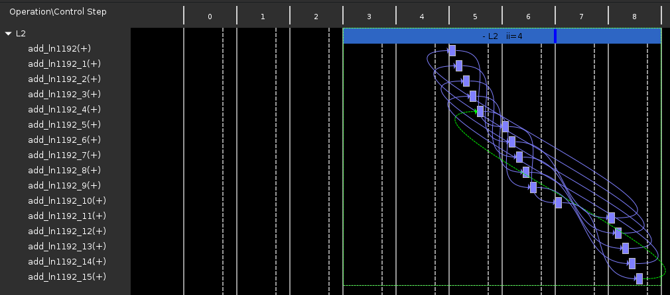
This is the II Violation in Vitis HLS Scheduler

Slide 38
Resolve the II Violation
void test(FIX_TYPE A[1024][1024], FIX_TYPE B[1024][1024], FIX_TYPE sum[1024])
{
#pragma HLS array_partition variable=A dim=2 factor=16 cyclic
#pragma HLS array_partition variable=B dim=2 factor=16 cyclic
L1: for(int i = 0; i < 1024; i++) { L2: for(int j = 0; j < 1024; j += 16) {
#pragma HLS pipeline
FIX_TYPE sum_local[16]; L3: for(int jj = 0; jj < 16; jj++)
sum_local[jj] = A[i][j + jj] * B[i][j + jj];
L4: for(int k = 0; k < 16; k++)
sum[i] += sum_local[k];
}}}
L3: for(int jj = 0; jj < 16; jj++)
sum[i] += A[i][j + jj] * B[i][j + jj];
Use a partitioned local buffer (registers)

Slide 39
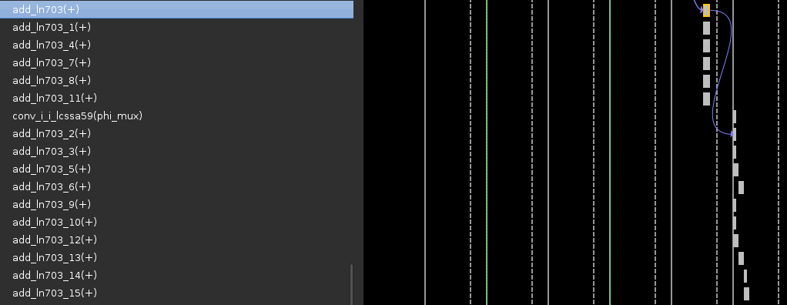
This is the schedule after II Violation Resolved
Seems that HLS is smart enough to build an efficient adder tree

Slide 40
Loop Partial Unroll
for(int i = 0; i < X; i++)
{
#pragma HLS unroll complete
a[i] = b[i] + c[i];
}
for(int i = 0; i < X; i++)
{
#pragma HLS unroll factor=2
a[i] = b[i] + c[i];
}
X must be known at compile time
Why?
X can be unknown at compile time
Why?
for(int i = 0; i < X; i += 2)
{
a[i] = b[i] + c[i];
if (i+1 >= X) break;
a[i+1] = b[i+1] + c[i+1];
}
Question: Does this mean partial unroll can replace loop tiling?
HLS can add a condition check

Slide 41
Loop Tiling v.s. Partial Unroll
When to use which?
 | Loop Tiling | Partial Unroll
# of loops | Can tile nested loops (e.g., processing a tensor) | Single loop
Memory | Can optimize memory access pattern (e.g., load a smaller tensor) | Do not optimize memory
Across-iteration accumulation | Can address accumulations (as in previous example) | Cannot address accumulations
Together with pipeline | Yes | Pipeline will override partial unroll and change to complete unroll

Slide 42
More Loop Optimizations
Initial Interval (II) Violation
Pipeline and Unroll over Functions
Loop-carried Dependency
Loop reorder
Remove false dependency
Loop Tiling and Partial Unroll
Loop Fusion
Parallel loops fused into single loop
Wrap loops into functions

Slide 43
Loop Fusion
When we have multiple loops, and they are independent:
for(int i = 0; i < max(I1, I2); i++)
if(i < I1) Do_Homework(i);
if(i < I2) Watch_A_Movie(i);
Merge into one
for(int i = 0; i < I1; i++)
Do_Homework(i);
for(int j = 0; j < I2; j++)
Watch_A_Movie(j);
// definition
Do_Homework_Wrapper() { first_for_loop}
Watch_A_Movie_Wrapper() { second_for_loop}
// function call
Do_Homework_Wrapper();
Watch_A_Movie_Wrapper();
Wrap them up

Slide 44
Summary – Loop Optimizations
Initial Interval (II) Violation
Can be caused by unpartitioned array, memory port limitation, repeated accumulation, true/false dependencies, etc.
Loop transform (change orders), create local buffers, etc.
Pipeline and Unroll over Functions
Loop-carried Dependency
Loop reorder
Remove false dependency
Loop Tiling: controlled parallelism – not too large!
Loop Fusion
Parallel loops fused into single loop or wrap loops into functions
There are many more tricks/pitfalls – I hope I can tell you all of them but impossible to enumerate
Hopefully, you can learn how to fix them on your own (Xilinx manual, etc.)

